Slide 1
Annotations Guidelines Images
Glossary for all the different events identified in the TUH EEG Corpus

Slide 2
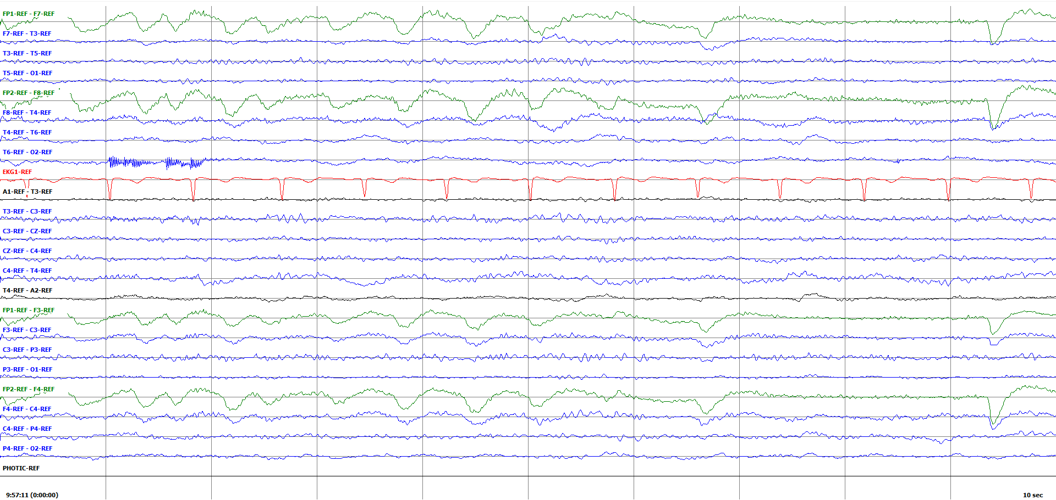
Multiple Eyeblinks (Eye fluttering?) /gluster_volume/data/isip/data/tuh_eeg_seizure/work/second_pass_set/edf/01_tcp_ar/030/00003005/s004_2010_06_18/ 030/00003005_s004_t001.edf

Slide 3
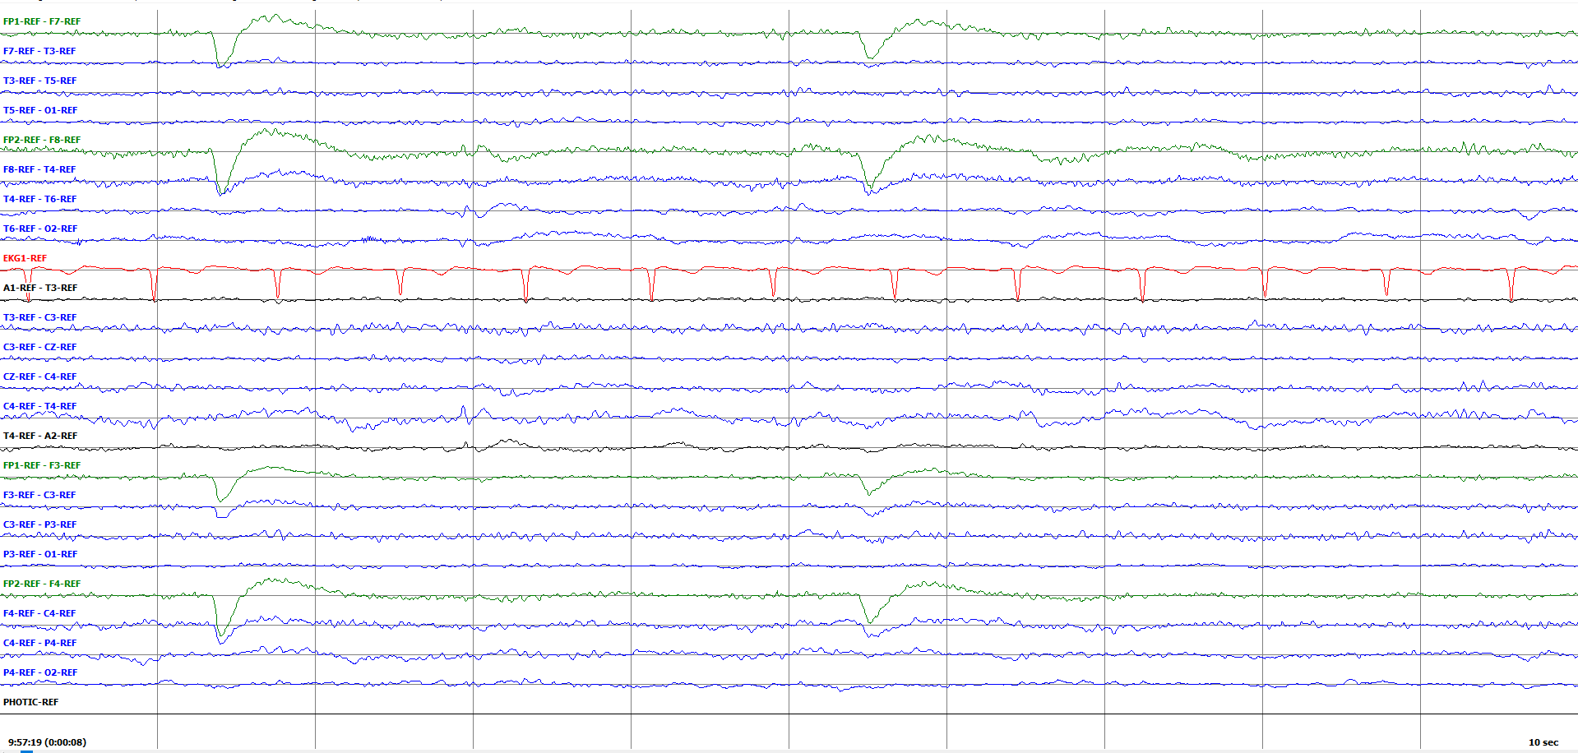
Eye Blink (Single events) /gluster_volume/data/isip/data/tuh_eeg_seizure/work/second_pass_set/edf/01_tcp_ar/030/00003005/s004_2010_06_18/ 030/00003005_s004_t001.edf

Slide 4
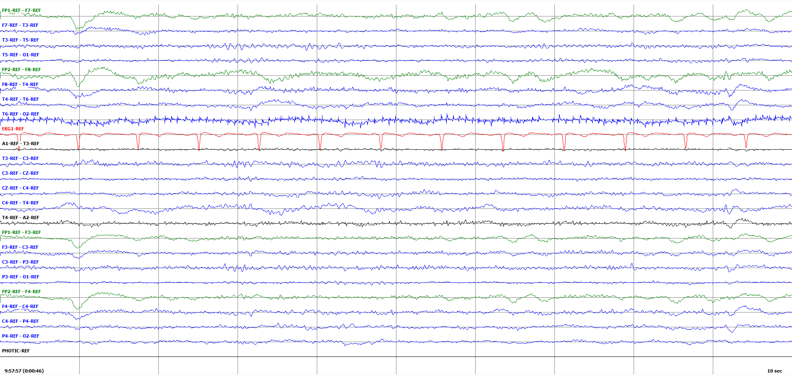
EMG artifact (T6-O2) /gluster_volume/data/isip/data/tuh_eeg_seizure/work/second_pass_set/edf/01_tcp_ar/030/00003005/s004_2010_06_18/ 030/00003005_s004_t001.edf

Slide 5
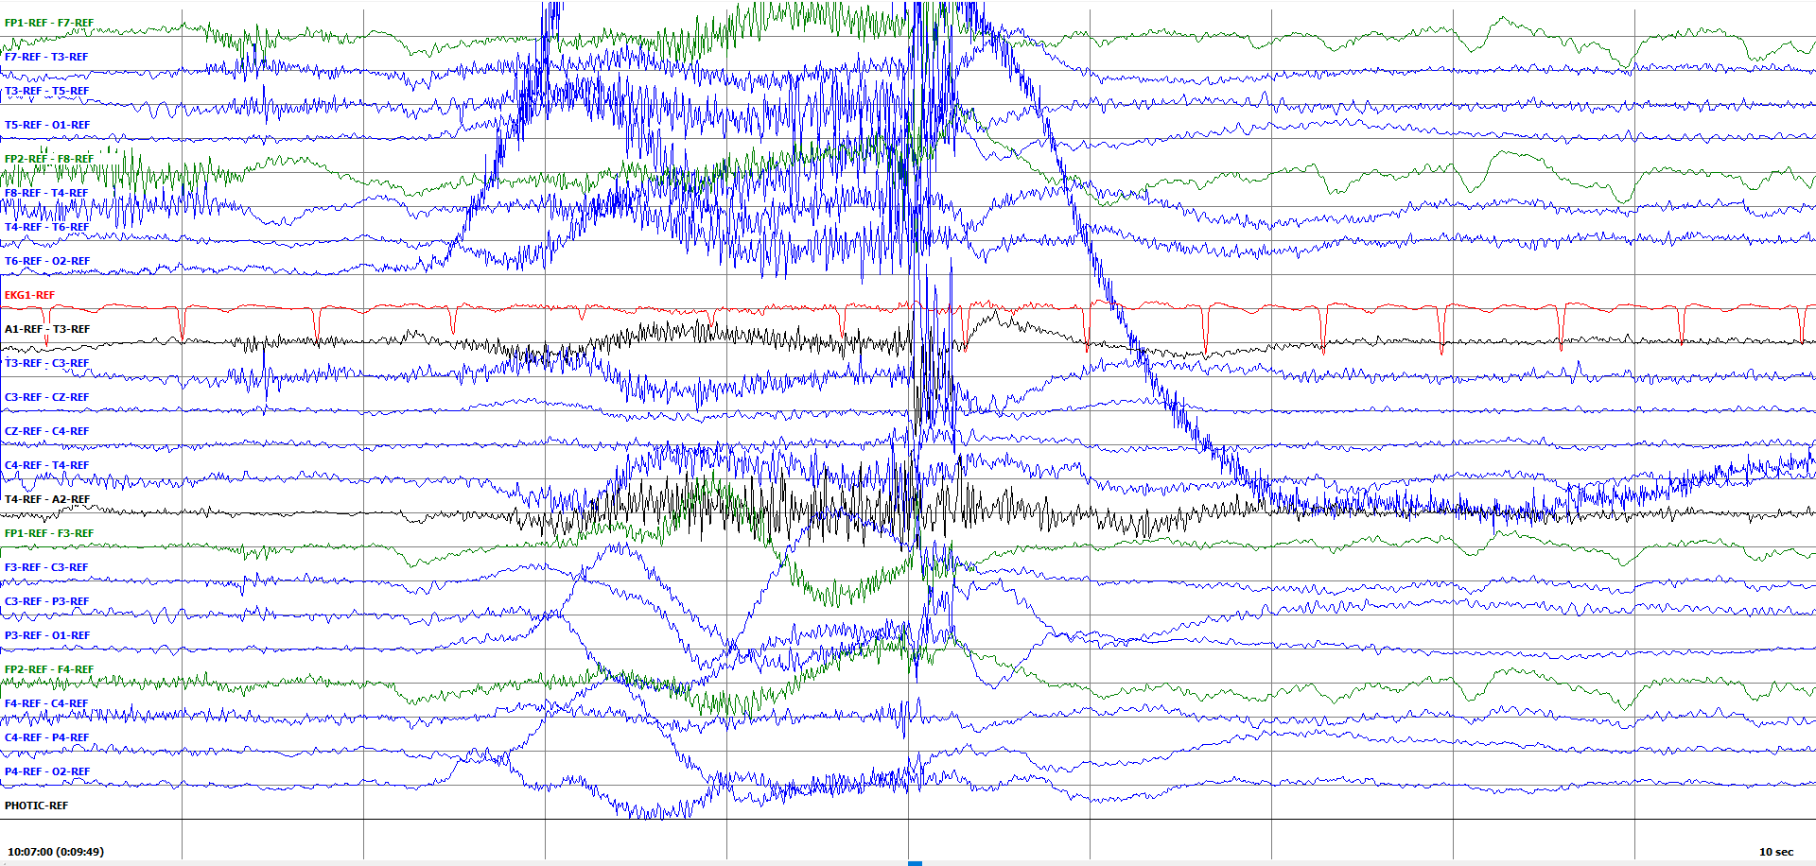
Electrode Movement*** /gluster_volume/data/isip/data/tuh_eeg_seizure/work/second_pass_set/edf/01_tcp_ar/030/00003005/s004_2010_06_18/ 030/00003005_s004_t001.edf

Slide 6
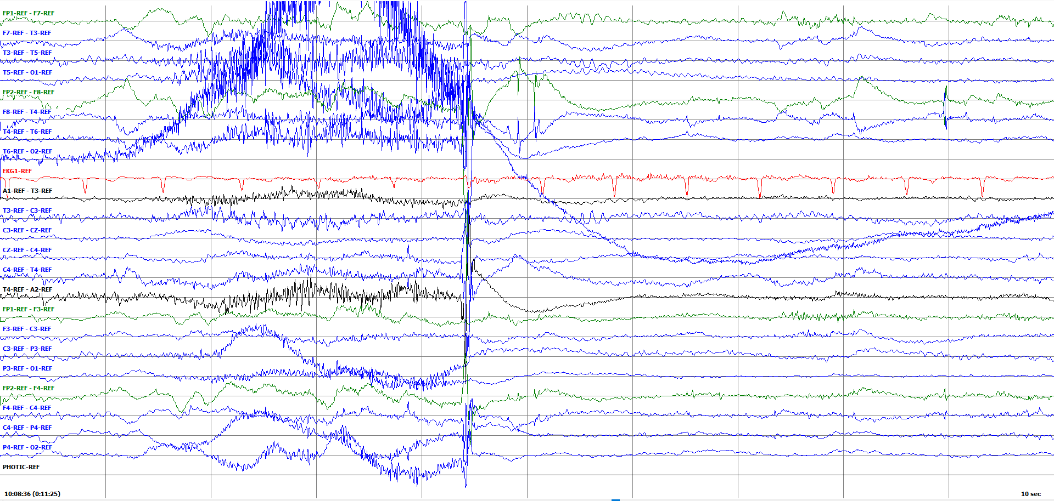
Electrostatic /gluster_volume/data/isip/data/tuh_eeg_seizure/work/second_pass_set/edf/01_tcp_ar/030/00003005/s004_2010_06_18/ 030/00003005_s004_t001.edf

Slide 7
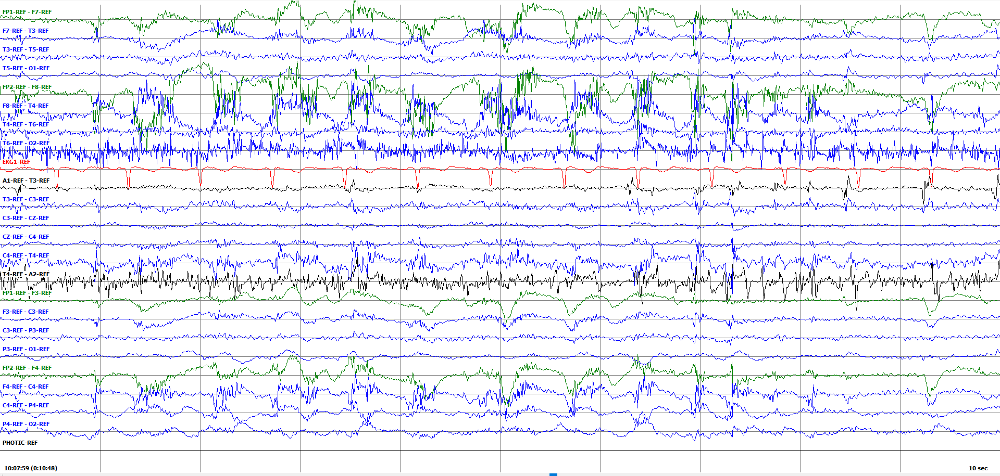
Jerking (myoclonous) /gluster_volume/data/isip/data/tuh_eeg_seizure/work/second_pass_set/edf/01_tcp_ar/030/00003005/s004_2010_06_18/ 030/00003005_s004_t001.edf

Slide 8
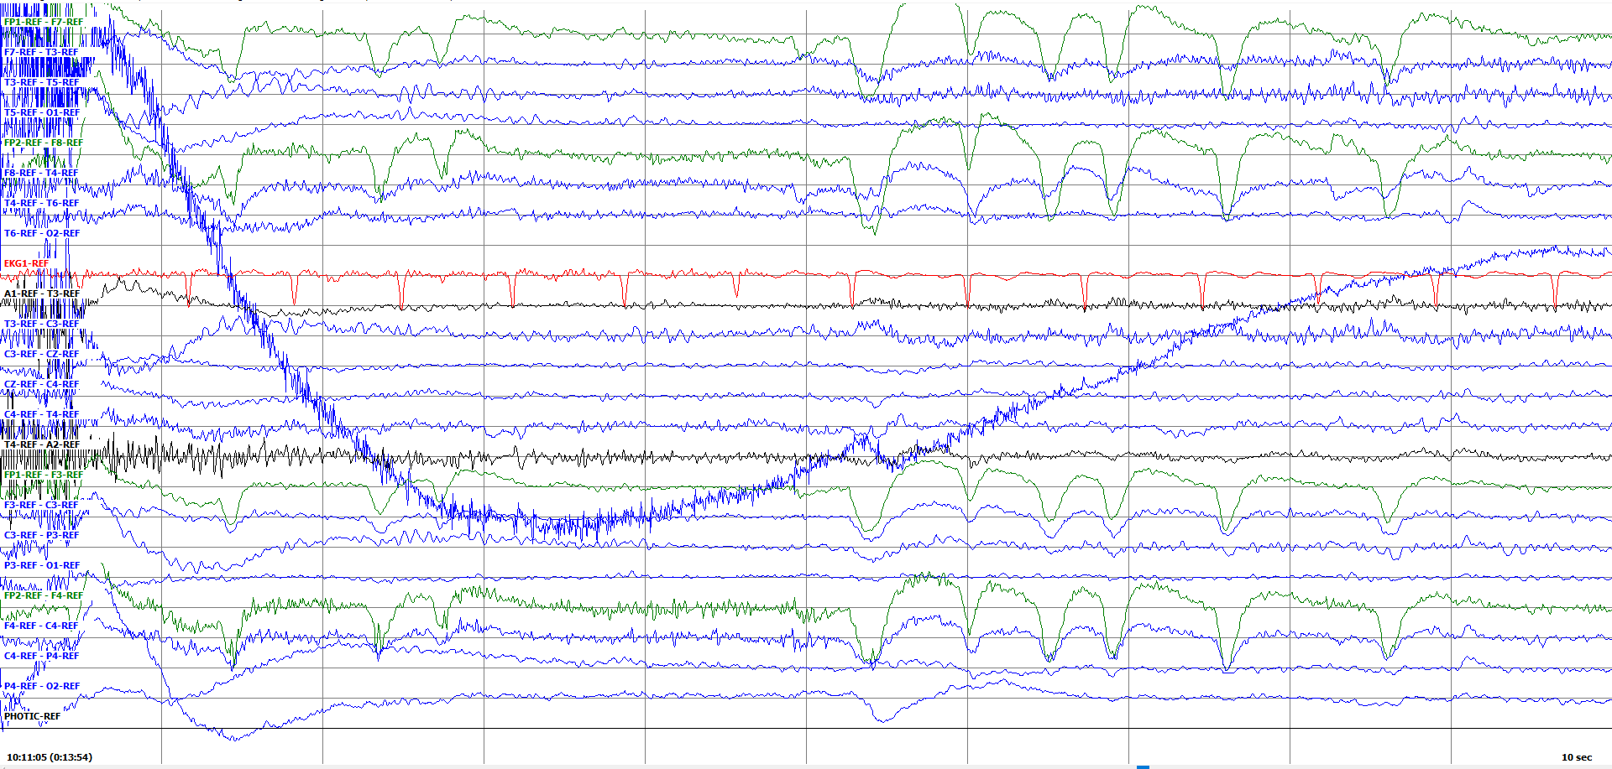
Lead Artifact /gluster_volume/data/isip/data/tuh_eeg_seizure/work/second_pass_set/edf/01_tcp_ar/030/00003005/s004_2010_06_18/ 030/00003005_s004_t001.edf

Slide 9
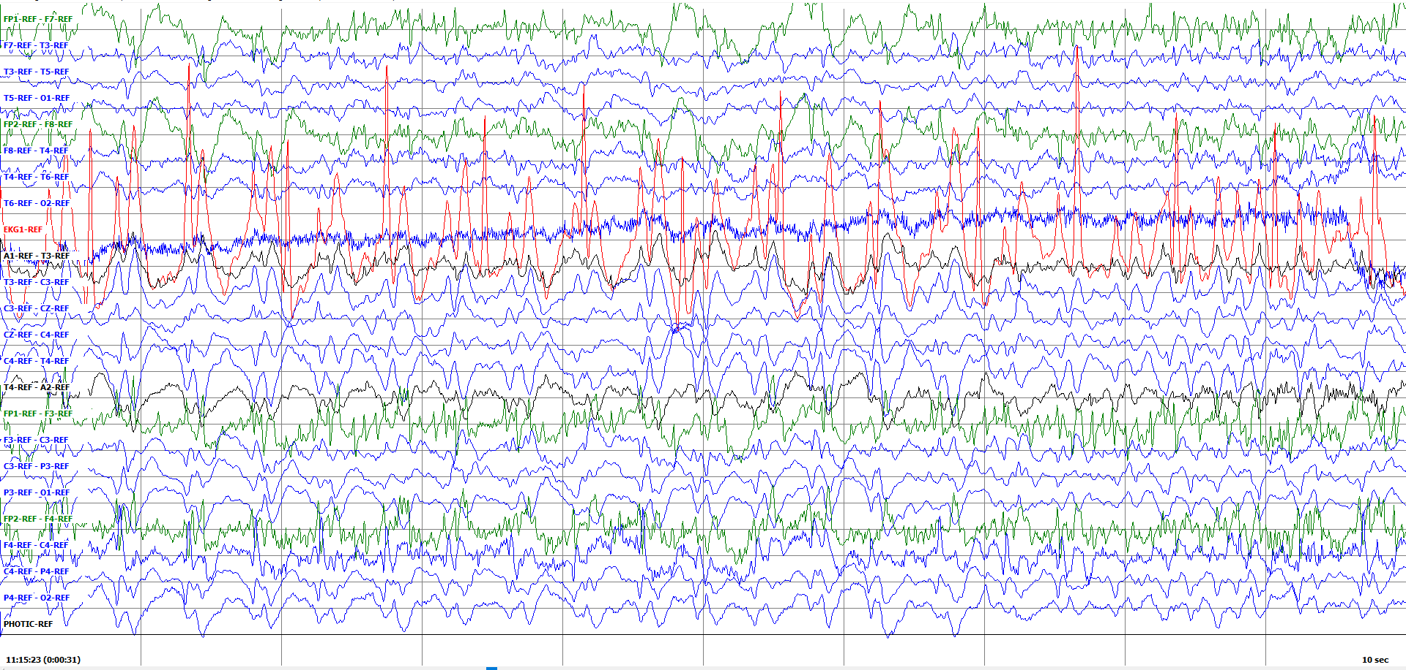
Complex Partial (report verified) /gluster_volume/data/isip/data/tuh_eeg_seizure/work/second_pass_set/edf/01_tcp_ar/044/00004456/s012_2014_06_18/00004456_s012_t002.edf

Slide 10
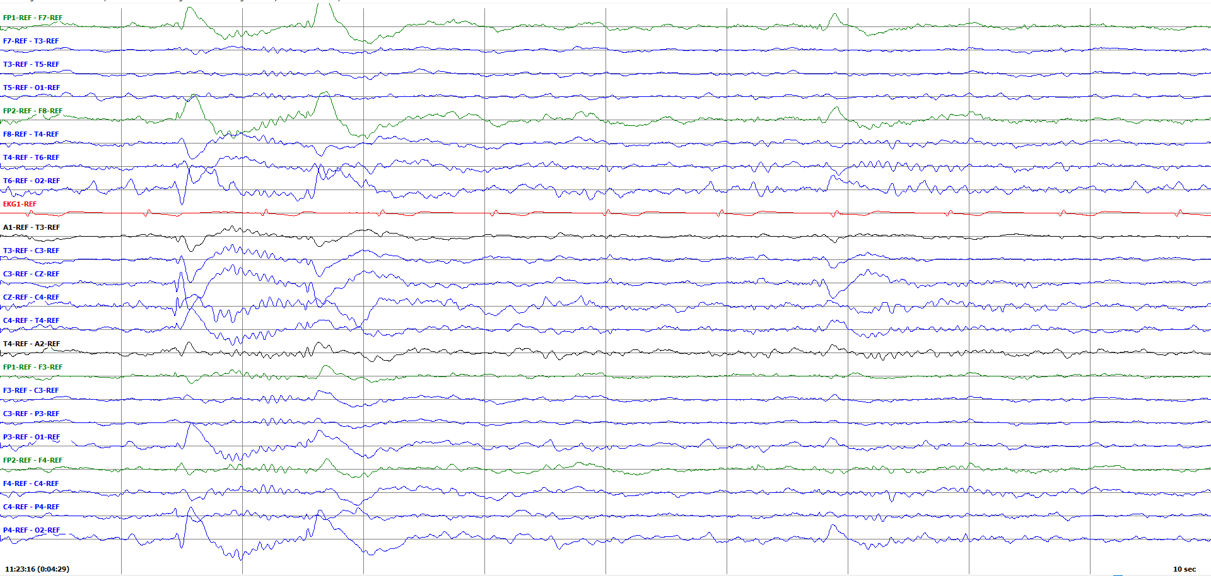
K compex followed by sleep spindle. I don’t really like this example, the K-complex is tied into something else. The vertex wave is good though. /gluster_volume/data/isip/data/tuh_eeg_seizure/work/second_pass_set/edf/01_tcp_ar/034/00003437/s006_2014_10_20/00003437_s006_t003.edf

Slide 11
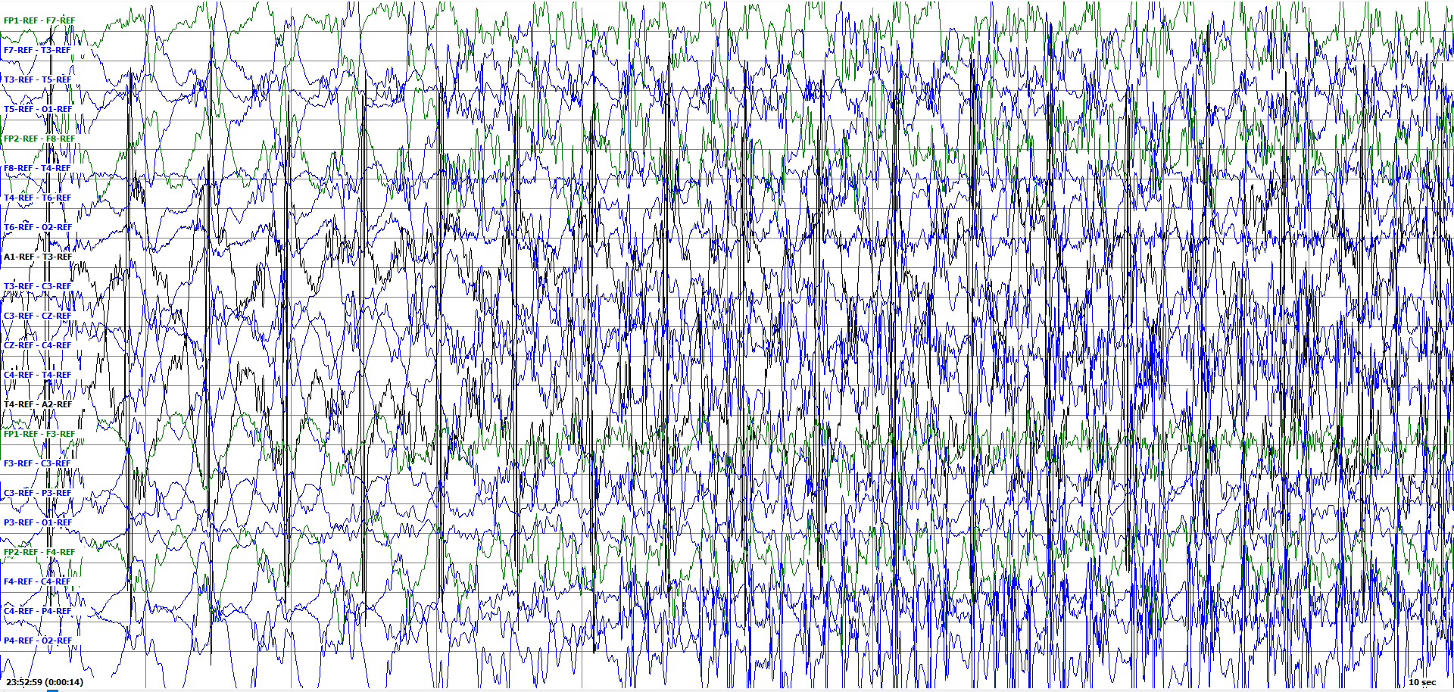
Tonic Clonic seizure (report verified) /gluster_volume/data/isip/data/tuh_eeg_seizure/work/second_pass_set/edf/01_tcp_ar/006/00000630/s002_2003_05_28/00000630_s002_t001.edf

Slide 12
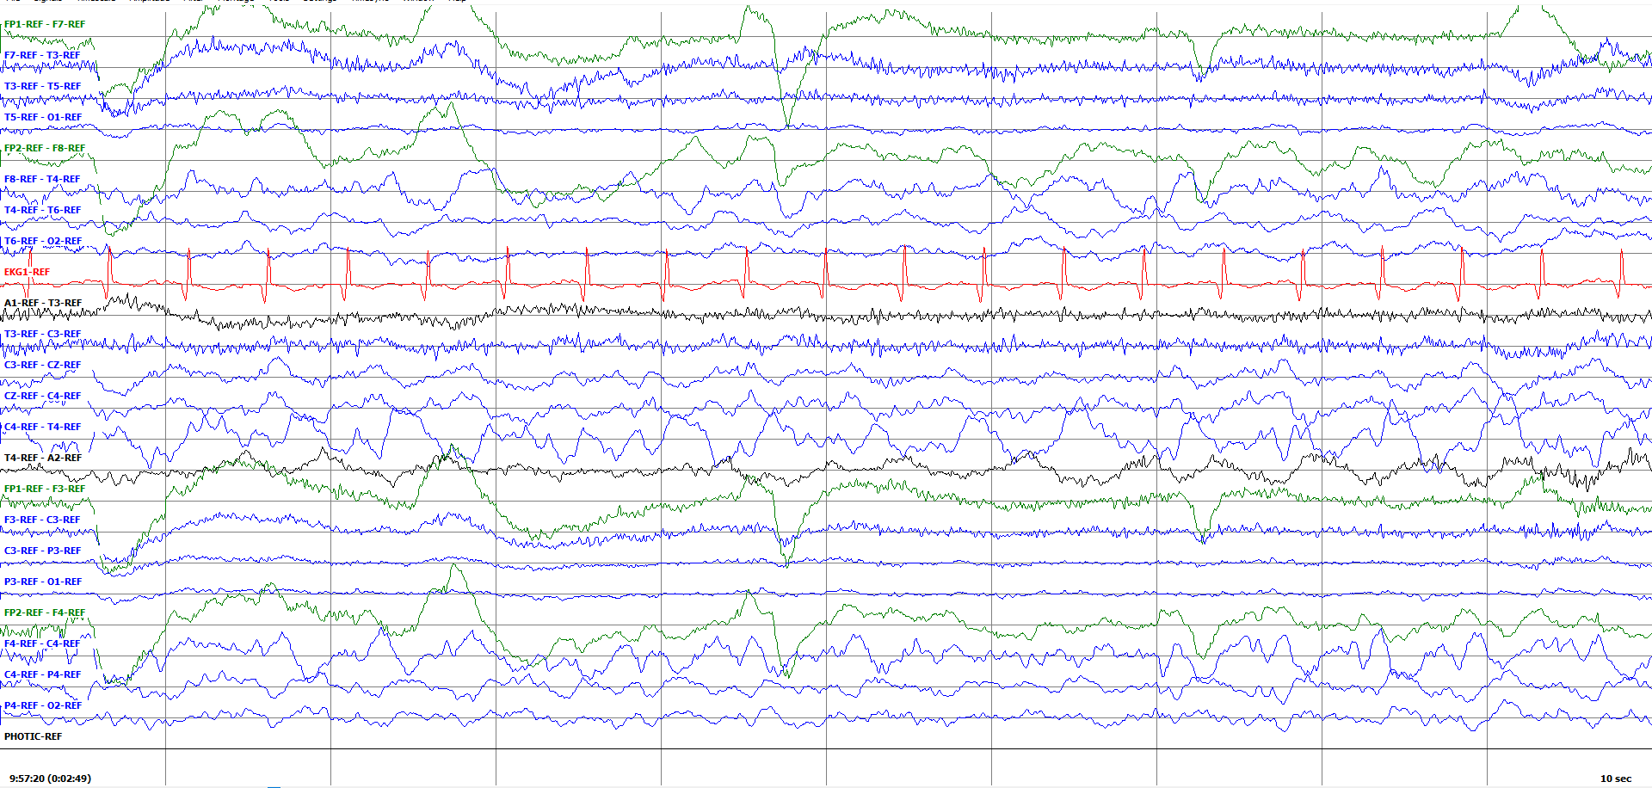
Breach Rhythm (report verified) /gluster_volume/data/isip/data/tuh_eeg_seizure/work/second_pass_set/edf/01_tcp_ar/077/00007793/s001_2011_05_27/00007793_s001_t000.edf

Slide 13
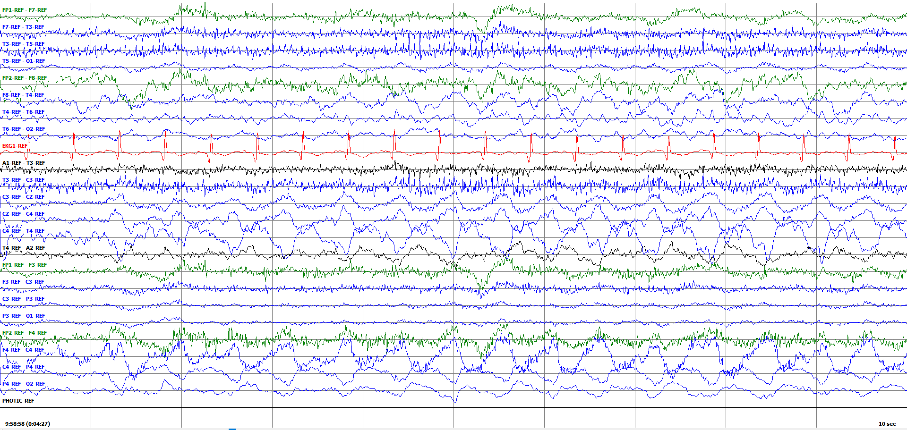
Pretty sure we annotated this as a FNSZ with breach on top /gluster_volume/data/isip/data/tuh_eeg_seizure/work/second_pass_set/edf/01_tcp_ar/077/00007793/s001_2011_05_27/00007793_s001_t000.edf

Slide 14
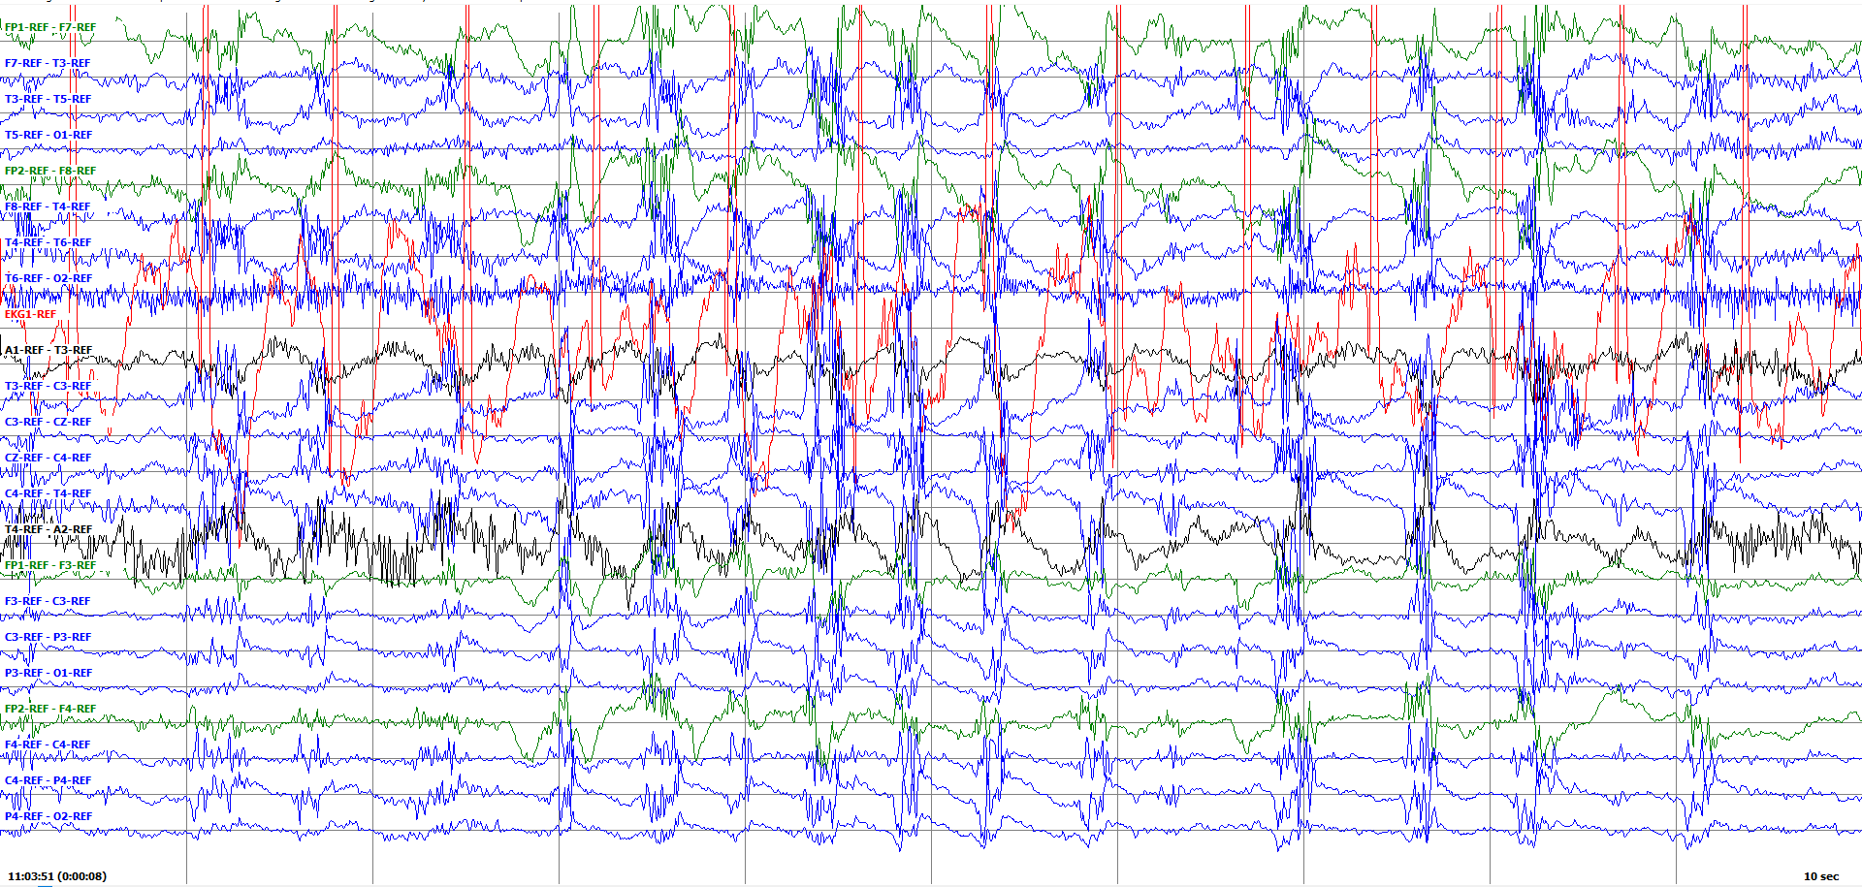
Chewing (report verified) /gluster_volume/data/isip/data/tuh_eeg_seizure/work/second_pass_set/edf/01_tcp_ar/019/00001981/s007_2015_03_30/00001981_s007_t003.edf

Slide 15
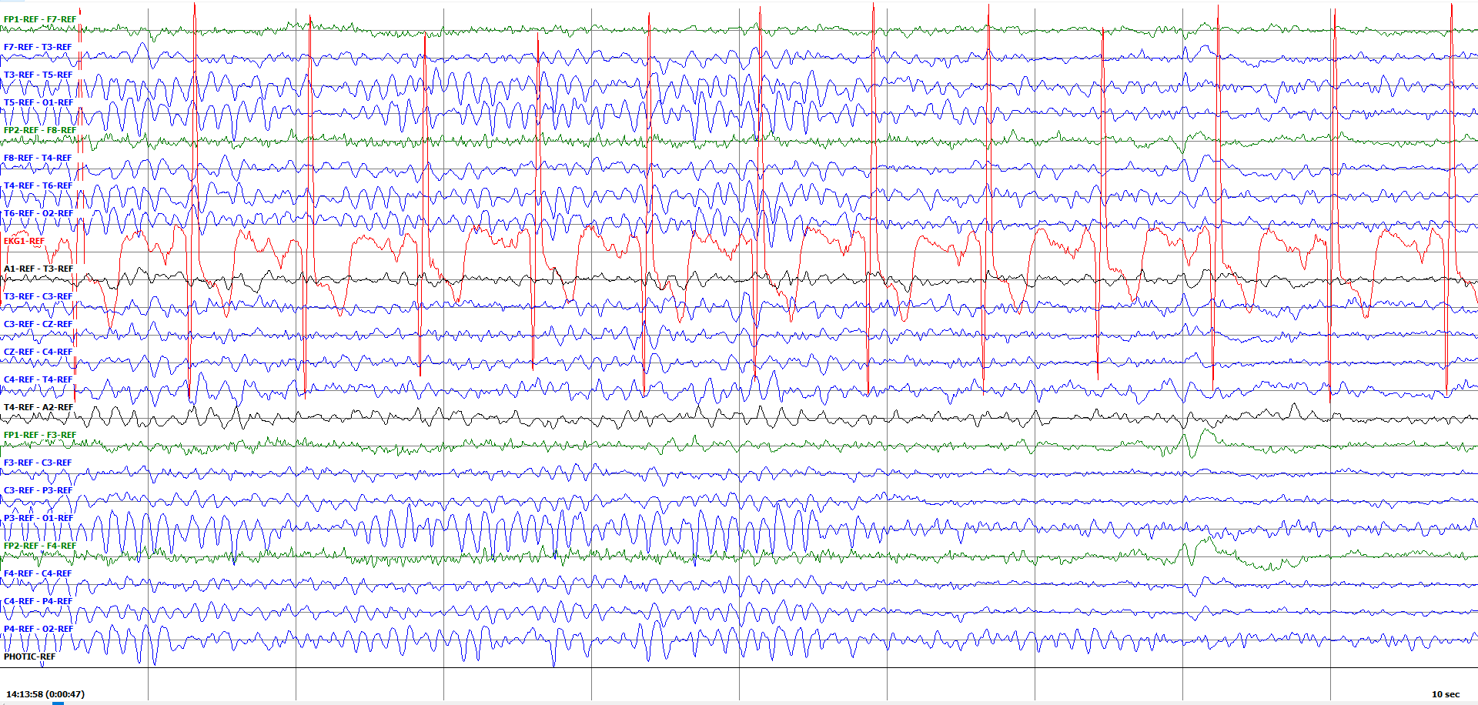
Slow alpha waves of youth (check age of patient) pt is 41, this is just alpha rhythm. /gluster_volume/data/isip/data/tuh_eeg_seizure/work/second_pass_set/edf/01_tcp_ar/023/00002322/s005_2013_09_19/00002322_s005_t000.edf

Slide 16
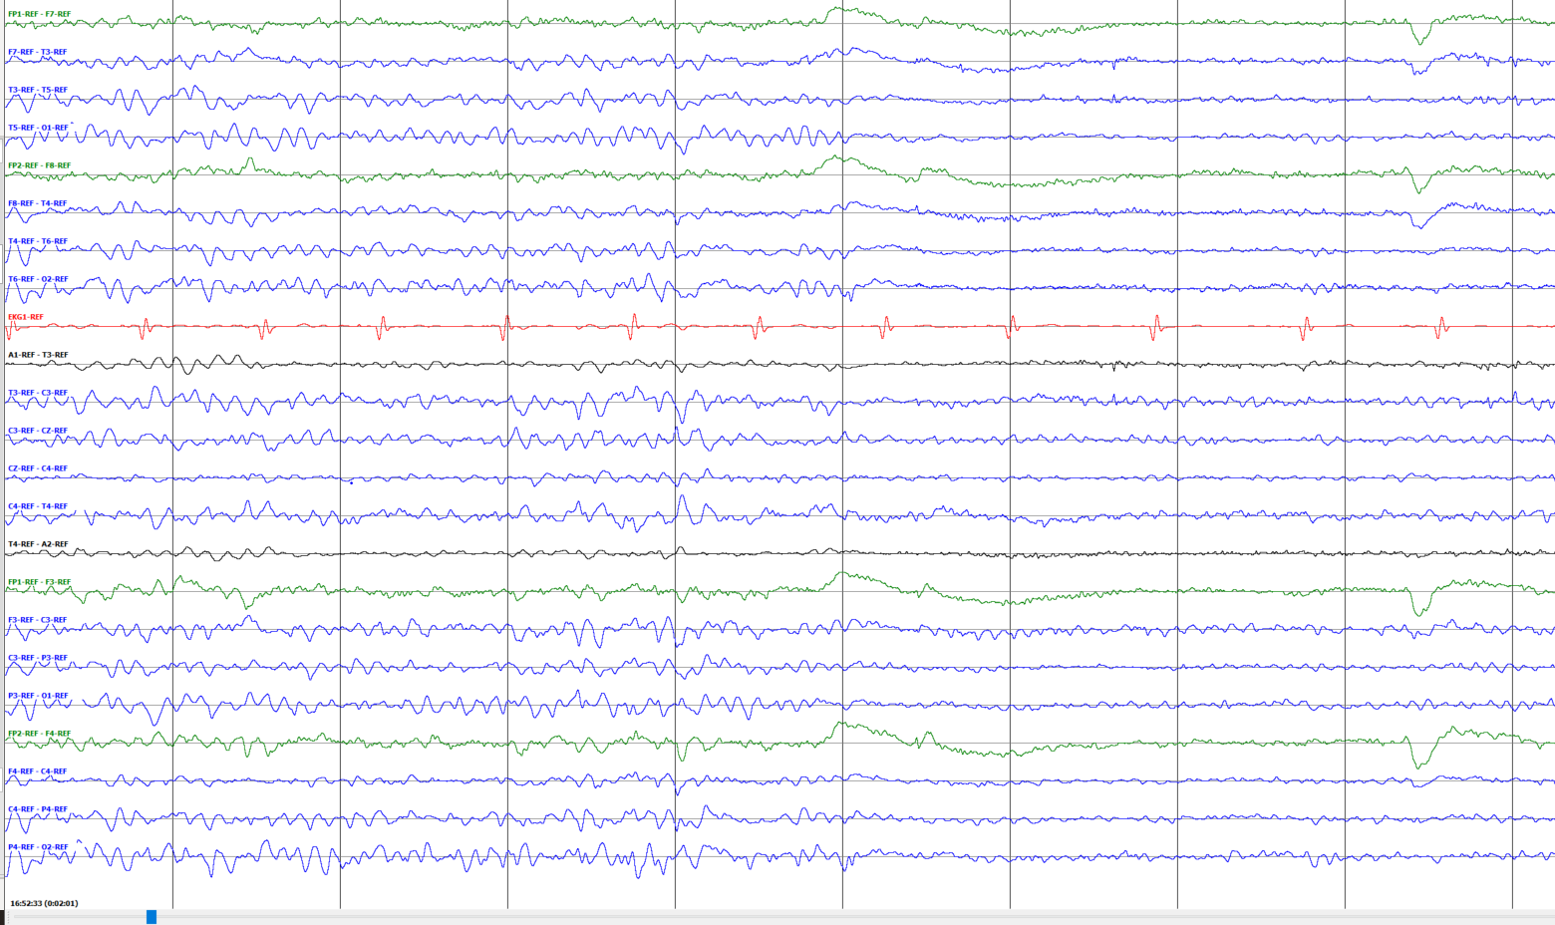
Posterior Dominant Rhythm normal EEG /gluster_volume/data/isip/data/tuh_eeg/v1.2.0/edf/01_tcp_ar/150/00015029/s001_2016_10_12

Slide 17
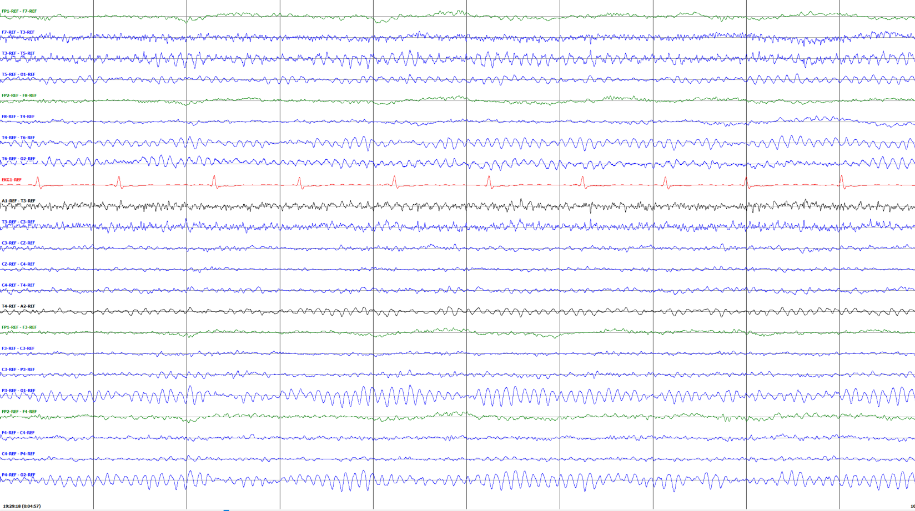
Alpha Waves of Youth (17 yo male) /gluster_volume/data/isip/data/tuh_eeg/v1.2.0/edf/01_tcp_ar/140/00014017/s001_2016_02_01

Slide 18
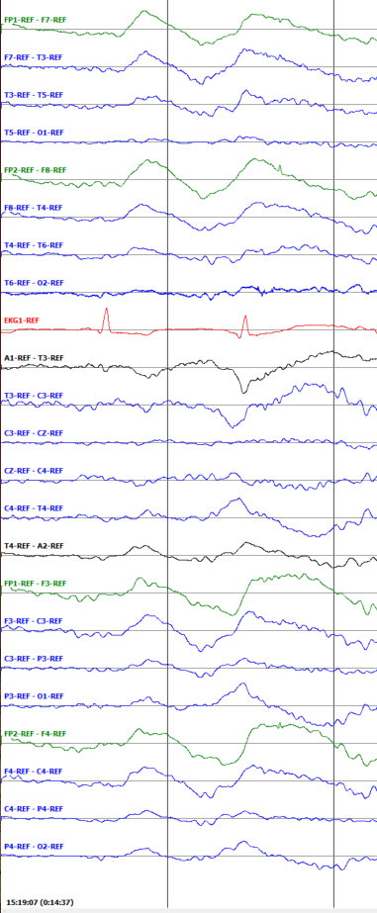
K Complex /gluster_volume/data/isip/data/tuh_eeg/v1.2.0/edf/01_tcp_ar/113/00011362/s002_2016_05_04

Slide 19
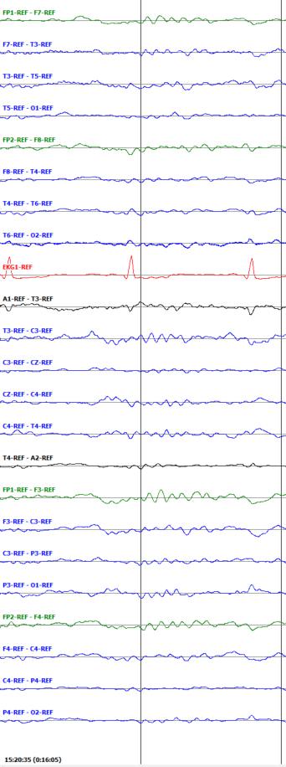
Sleep Spindle /gluster_volume/data/isip/data/tuh_eeg/v1.2.0/edf/01_tcp_ar/113/00011362/s002_2016_05_04

Slide 20
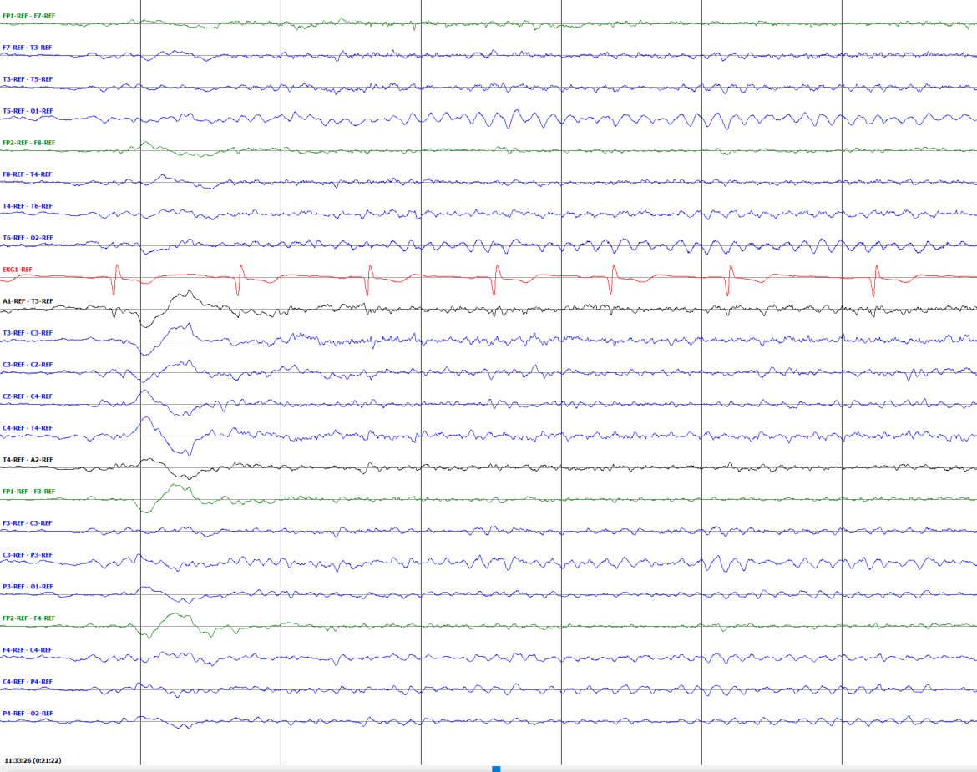
K-Complex + sleep spindle gluster_volume/data/isip/data/tuh_eeg/v1.2.0/edf/01_tcp_ar/113/00011345/s004_2016_07_19

Slide 21
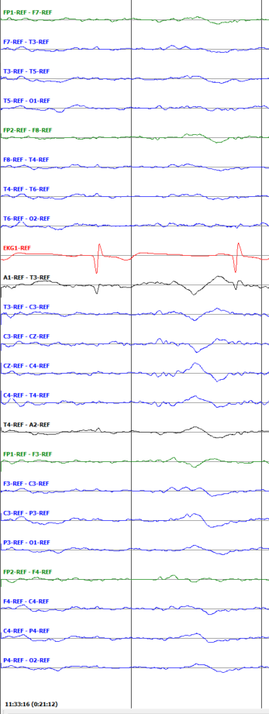
Vertex Wave /gluster_volume/data/isip/data/tuh_eeg/v1.2.0/edf/01_tcp_ar/113/00011345/s004_2016_07_19

